Slide 1
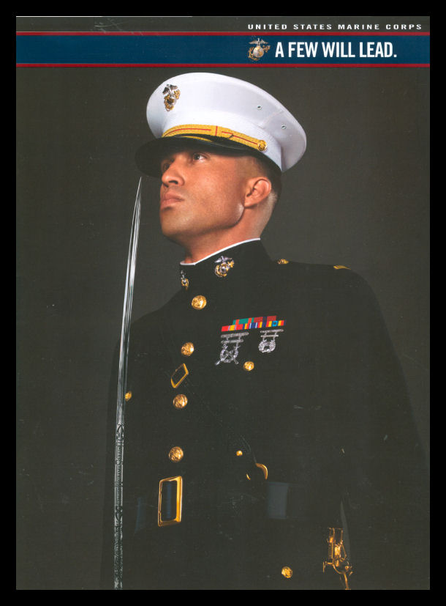
Naval Reserve Officers Training Corps Scholarship
Minimum Qualifications
SAT: 1000
ACT: 22
ASVAB: 74
Between the ages: 17-23
U.S. Citizen
Physically Qualified
The NROTC program provides a full tuition
scholarship.
Altogether, the value of a four year full
scholarship amounts to
$180,000
Contact Staff Sergeant Nyron Smith at (717) 585-1434 for more details.

