Slide 1

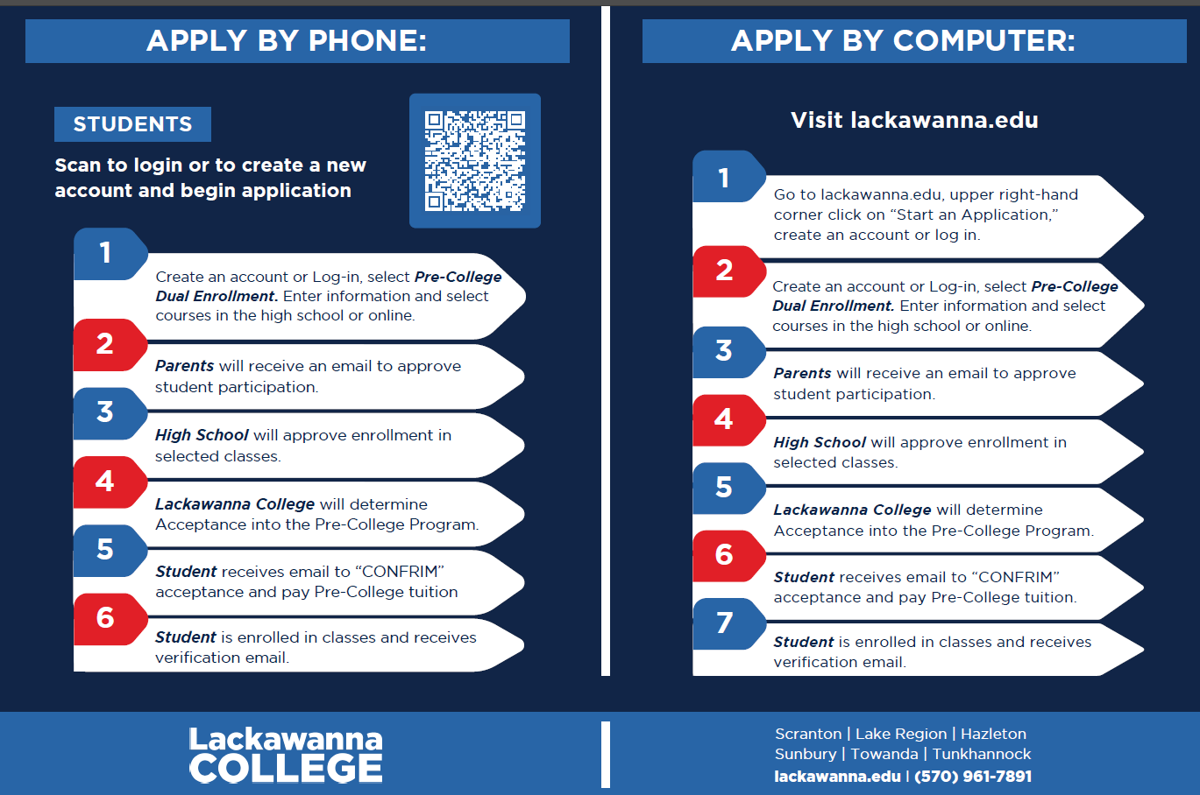

Dual Enrollment Lackawanna College
English 12
Chemistry
Math Modeling
Economics
American Government
Contact your School Counselor for more details.
*** Application will ONLY be completed online this year. Deadline is 11/21/2025, NO EXCEPTIONS***
Registration Requirements:
3.0 Cumulative GPA
Cost:
$100 Per Credit

